Slide 1
Tapping the Well of Creativity

Slide 2
A Brief History of Thoughts about Creativity

Slide 3
The Greeks
Tension between the rational and irrational.
Creativity involves the irrational.
Believed ideas were sent from the gods because ideas would simply appear, surprisingly.
Poet was a man set apart from common humanity by an abnormal inner experience (Plato, Apology).
Poetry was set apart from reason and above reason (Plato, Apology).
“Not by wisdom do poets write poetry, but by a sort of genius and inspiration; they are like diviners or soothsayers who also say many things, but do not understand the meaning of them” (Plato, Apology).

Slide 4
The Greeks
Plato: the artist is both inspired and out of his mind—both graced with supernatural powers and touched with madness.
Aristotle thought melancholia was central to creativity.
A person could get ideas through a form of divine madness (four types).
  Prophetic madness
  Ritual madness
  Erotic madness
  Poetic madness- brought about by a muse and produces ideas.

Slide 5
The Greeks
Nine muses, the children of Mnemosyne, the goddess of memory, and Zeus.
Calliope for epic poetry
Clio for history
Erato for love poetry
Euterpe for music
Polyhymnia for hymns
Terpsichore for song and dance
Melpomene for tragic theater
Thalia for comic theater
Urania for astronomy

Slide 6
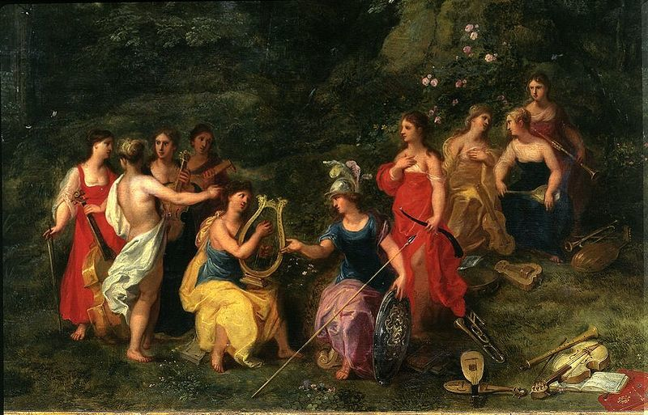

Slide 7
Middle Ages
Conceptually, the words used showed a division between facere or “to make” as a human thing, and creāre or “to create” belonging to god.
Creativity the will of one god.
One god responsible for all creation: God was Creator.
Humans were god’s “tools”: Humans were Makers.
Augustine classified curiosity (curiositas) as a sin, saying it turned people away from the pure contemplation of God.
Curiosity led to temptation.

Slide 8
The Renaissance
Attitude toward curiosity became positive.
Source of inspiration no longer external, but instead, situated within man as part of man’s God-given endowment.
Creativity was an internal capacity shared in varying degrees by all people, but amounting to genius in a few overwhelmingly gifted individuals.
Creativity was the sole technique for understanding the universe.

Slide 9
Modern Times
Early 19th Century: The ability to create was equated with genius, which was seen as both a gift and affliction—a pathology.
First recorded use of the term creativity was in 1875. (Creation, creator were around much before then.)
Forms of artistic expression (fine arts) not considered the only products of creativity.
Creativity is a product of the mid-twentieth century and of the modern West (Pope, 2005).
Interest in creativity grew during the first half of the twentieth century, at first as push-back to automation—mechanistic approach to management (machine model).

Slide 10
Modern Times
Interest in creativity grew after WWII in psychology and industry.
Change in industry’s needs from efficiency in manufacturing to inventiveness in science, technology, consumer products, marketing.
Former workplace values of rational order, mechanistic approaches to management and production did not fit new needs.
Conformity and alienation seen as stifling American ingenuity.
Idea of the creative person emerged.
Workers (usually white-collar workers) were to model themselves after poets or artists rather than machines.

Slide 11
Modern Times: Psychology
Post-WWII era was a deeply psychological age.
Preference for psychological explanations over structural explanations.
Attempt to find solutions to problems on a therapeutic rather than structural level.
Goal was to identify creative people, creative talent.
Much research conducted, aimed at systematically producing knowledge about creativity, defining it, quantifying it.
Tests developed to identify creative people.
Reified creativity—helped make it into the “thing” it is today.

Slide 12
Modern Times: Management
Management theories focused on creativity were developed.
Focus on creative problem solving.
Brainstorming, a form of divergent thinking done by groups, became popular in the 1950’s.
Pushback to brainstorming: Groups don’t think, individuals do.
Quest for creative thinking techniques—ways of training.
Creativity seen as a skill or procedure.

Slide 13
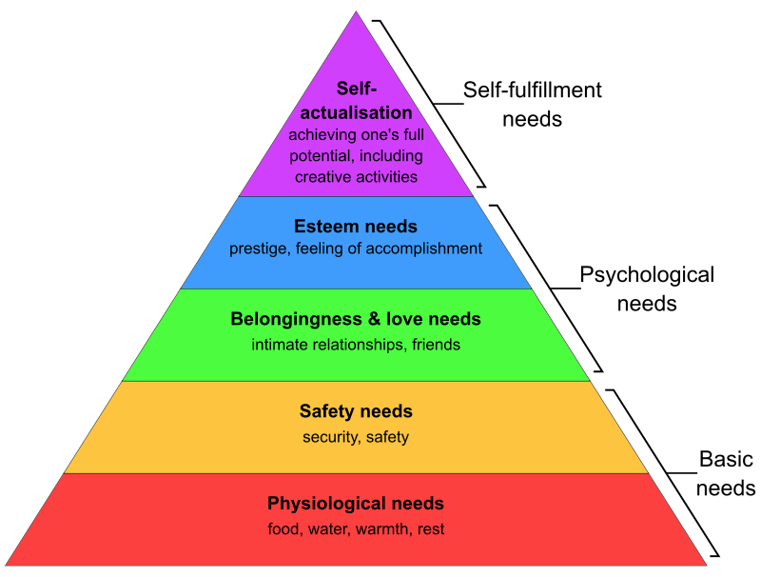
Modern Times: Psychology

Slide 14
Modern Times: Psychology
Maslow: Creativity and self-actualization linked.
Carl Rogers: saw creativity as the expression of human nature in its fullest flowering.”
Accomplishment seen as proof of inner flourishing.
Criticism arose:
  No clear definition of creativity.
  Issues with validity of tests to identify creative people.

Slide 15
Creativity ranked as the most important leadership quality for success in business—ranked over integrity and global thinking (Poll of 1,500 CEOs, 2010).

Slide 16
What Is Creativity?

Slide 17
Creativity Is…
A talent, an ability that characterizes a person; innate,
An act of bringing something new into existence.
A force or energy coming from outside the person.

Slide 18
Creativity Is…
A thought process involving imagination.
  Exploratory: Generating new ideas within a given space (a predefined, known environment). Solving a problem within that space.
  Transformational: Generating new ideas outside of a given space by transforming the space. Challenging what you know about the problem space rather than the problem. (Paradigm shift)
  Combinational: Combining old ideas to come up with something new.
    Problem-driven: bridge that gap by combining old ideas. These old ideas may offer an incomplete solution on their own but, once combined, prove to be a powerful solution.
    Similarity-driven: Some concepts are naturally associated inside our mind because they share similar functions, designs, and purposes.
    Inspiration-driven: mind connects two seemingly unrelated ideas to form a new one.

Slide 19
Creativity Is…
A thought process.
Kellerman & Seligman identified four types of creative thinking:
  Integration: combining diverse ideas and concepts to create innovative solutions.
  Splitting: breaking complex ideas and concepts into smaller, more manageable components, allowing for a deeper understanding and the development of novel solutions.
  Figure-ground reversal: challenging assumptions and perspectives to reveal new perspectives and opportunities.
  Distal thinking, transcending current beliefs, experiences, timeframes, and contexts by considering distant, unfamiliar, abstract concepts.

Slide 20
Creativity Is…
A thought process.
Creativity involves divergent thinking: Non-linear. Generating ideas and discovering multiple options for addressing problems.
Different from convergent thinking, Linear and analytical. Gathering facts to find the right answer.
Types of divergent thinking:
  Fluency – the ability to develop large numbers of ideas,
  Flexibility – the ability to produce ideas in numerous categories,
  Originality - the ability to produce unusual or unique ideas,
  Elaboration – the ability to adapt abstract ideas into realistic solutions.

Slide 21
Creativity Is…
A way of being.
A way of perceiving.
A practice of paying attention.
Refining our sensitivity to tune in to the more subtle notes.
Looking for what draws us in and what pushes us away.
Noticing what feeling tones arise and where they lead.
(Rubin, R. The Creative Act)

Slide 22
Words Associated with Creativity
Creativity
Creative People
Inventiveness
Ingenuity
Inspiration
Imagination
Innovation
Genius
Original, novel
Curious
Open to new ideas, experiences
Preference for asymmetrical figures
Preference for abstract art
High tolerance for ambiguity
Non-conforming
Freedom of expression
Emotionally attuned
Willingness to take risks

Slide 23
We All Are Creative
Creativity is not the domain of the select, gifted few.
The creative impulse is hard-wired into the operating system of the human brain.
The brain automatically and continually forms new associations.
Can increase creativity through training programs.

Slide 24
“That feeling of making something, of having an idea and then making it happen, of seeing something take shape in your hands, the one I occasionally had writing this book—it’s beautiful and mysterious and life-affirming and I’m not sure what to call it other than creativity.”
Franklin, Samuel W.. The Cult of Creativity: A Surprisingly Recent History (p. 206). The University of Chicago Press. Kindle Edition.

Slide 25
Tapping into Creativity

Slide 26
Benefits of Creative Self-Expression
Artistic expression helps to externalize emotion and build resilience for dealing with uncertainty and change.
Creative arts interventions include art, dance movement, drama, music, writing.
Used to treat depression, stress, trauma, anxiety and pain, e.g., depressive symptoms in older adults, PTSD in veterans, emotional lability in prisoners.
Saliva samples taken after 45 minutes of art making showed a statistically significant lowering of cortisol levels.

Slide 27
Awareness
Awareness involves noticing what’s going on around and inside ourselves in the present moment, and to do so without attachment or judgment.
We tend to use only one or two senses at a time and only in certain contexts.
  Sight (We live in a visual culture)
  Sound (Sometimes accompanied by sight.)
  Smell (Sometimes accompanied by sight. “That looks delicious!”)
  Taste (Sometimes accompanied by smell.)
  Taste
  Touch (Sometimes accompanied by sight and smell.)
Use of the word “see” to indicate knowledge, understanding, recognition.

Slide 28
Spain, About 10,000 Years Ago

Slide 29
Australia (25,000 years ago)

Slide 30
France 30,000 Years Ago

Slide 31
Patagonia, Argentina 9,000 Years Ago

Slide 32
Assignment
What does being more creative “look like” for you?
Set aside a time each day to open yourself to the creative process. During that time, take a walk, listen to music, dance, write a story, jot down thoughts, play an instrument—anything that strikes you during that time. Employ all senses. Focus on becoming aware, but not by force! Perhaps collect some ideas about creative endeavors. How did you feel during that time? What thoughts came up for you? How did you react to those thoughts?

Slide 33
Contender for Oldest 40,000-45,000 Years Ago
Indonesian Island of Sulawesi

Slide 34
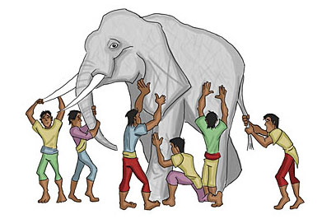
Six Blind Men and the Elephant

Slide 35
Six Blind Men and the Elephant
The parable of The Blind Men and The Elephant tells the story of six blind men who examine one part of an elephant.
Each man comes to very different conclusions about what an elephant is based on what he has touched.
Although each man touches the same animal, his determination of the elephant is based on only what he is able to perceive.
Interpretations differ.
Your experiences with the arts and aesthetics are so singular because your brain-connectivity patterns are distinctive. No one else has your exact brain!
BUT, even your brain-connectivity patterns change!

Slide 36
Why Do We Create?

Slide 37
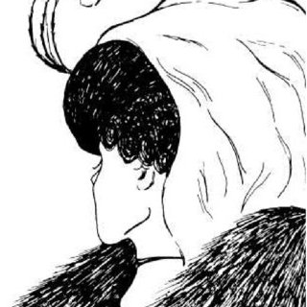
Shifting Focus

Slide 38
Inspiration
IThe word inspire comes from the Latin inspira: “to breathe in.”
Something that comes to us from the surrounding air, like a winged spirit filling us with insight.
Inspiration is a mystical, intangible thing that grasps the artist, the writer, the inventor, and even the scientist.
In Greek mythology, the muses (women) were deemed to be the source of that inspiration. They presided over the arts and sciences, often helping and guiding people (men) towards magnificent ideas and discoveries.
We get the word “museum” from “muse”, which is fittingly a place where creativity is gloriously displayed.

Slide 39
Getting Inspired!
Artistic inspiration manifests in different ways for different artists.
It might arise from a deep emotional connection to a particular type of person or a group of people.
Artistic inspiration might come from a certain place/location that incites creativity.
Museums are a source of inspiration for many people, as are concerts, theater, great books, poetry readings, etc.
Reading about other artists’ lives and works.
Many artists still find a spiritual calling from specific people whom they regard as their creative muse.

Slide 40
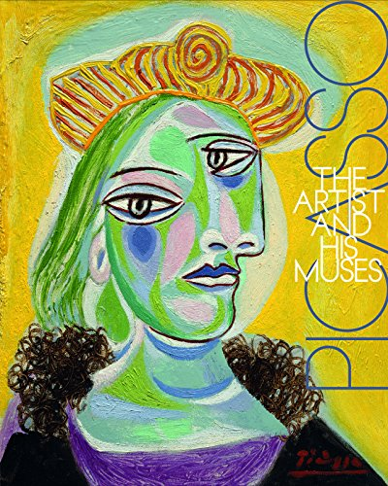

Slide 41
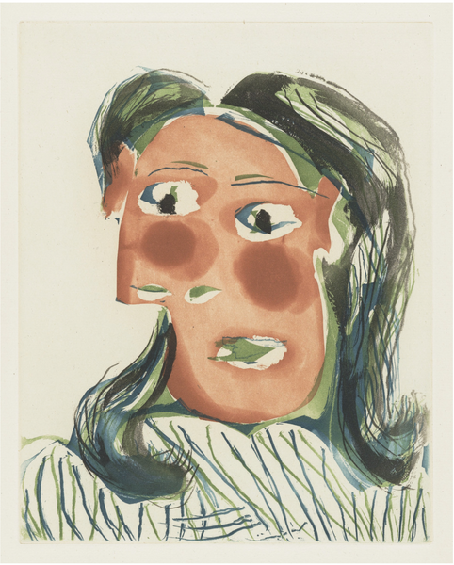

Slide 42
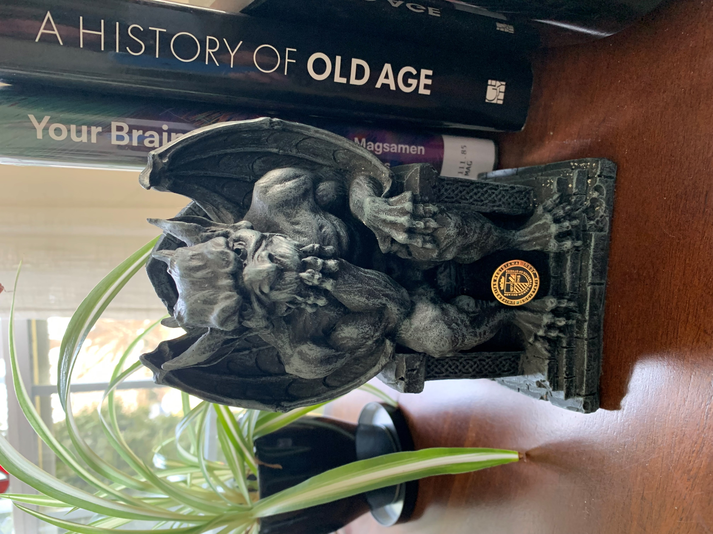

Slide 43
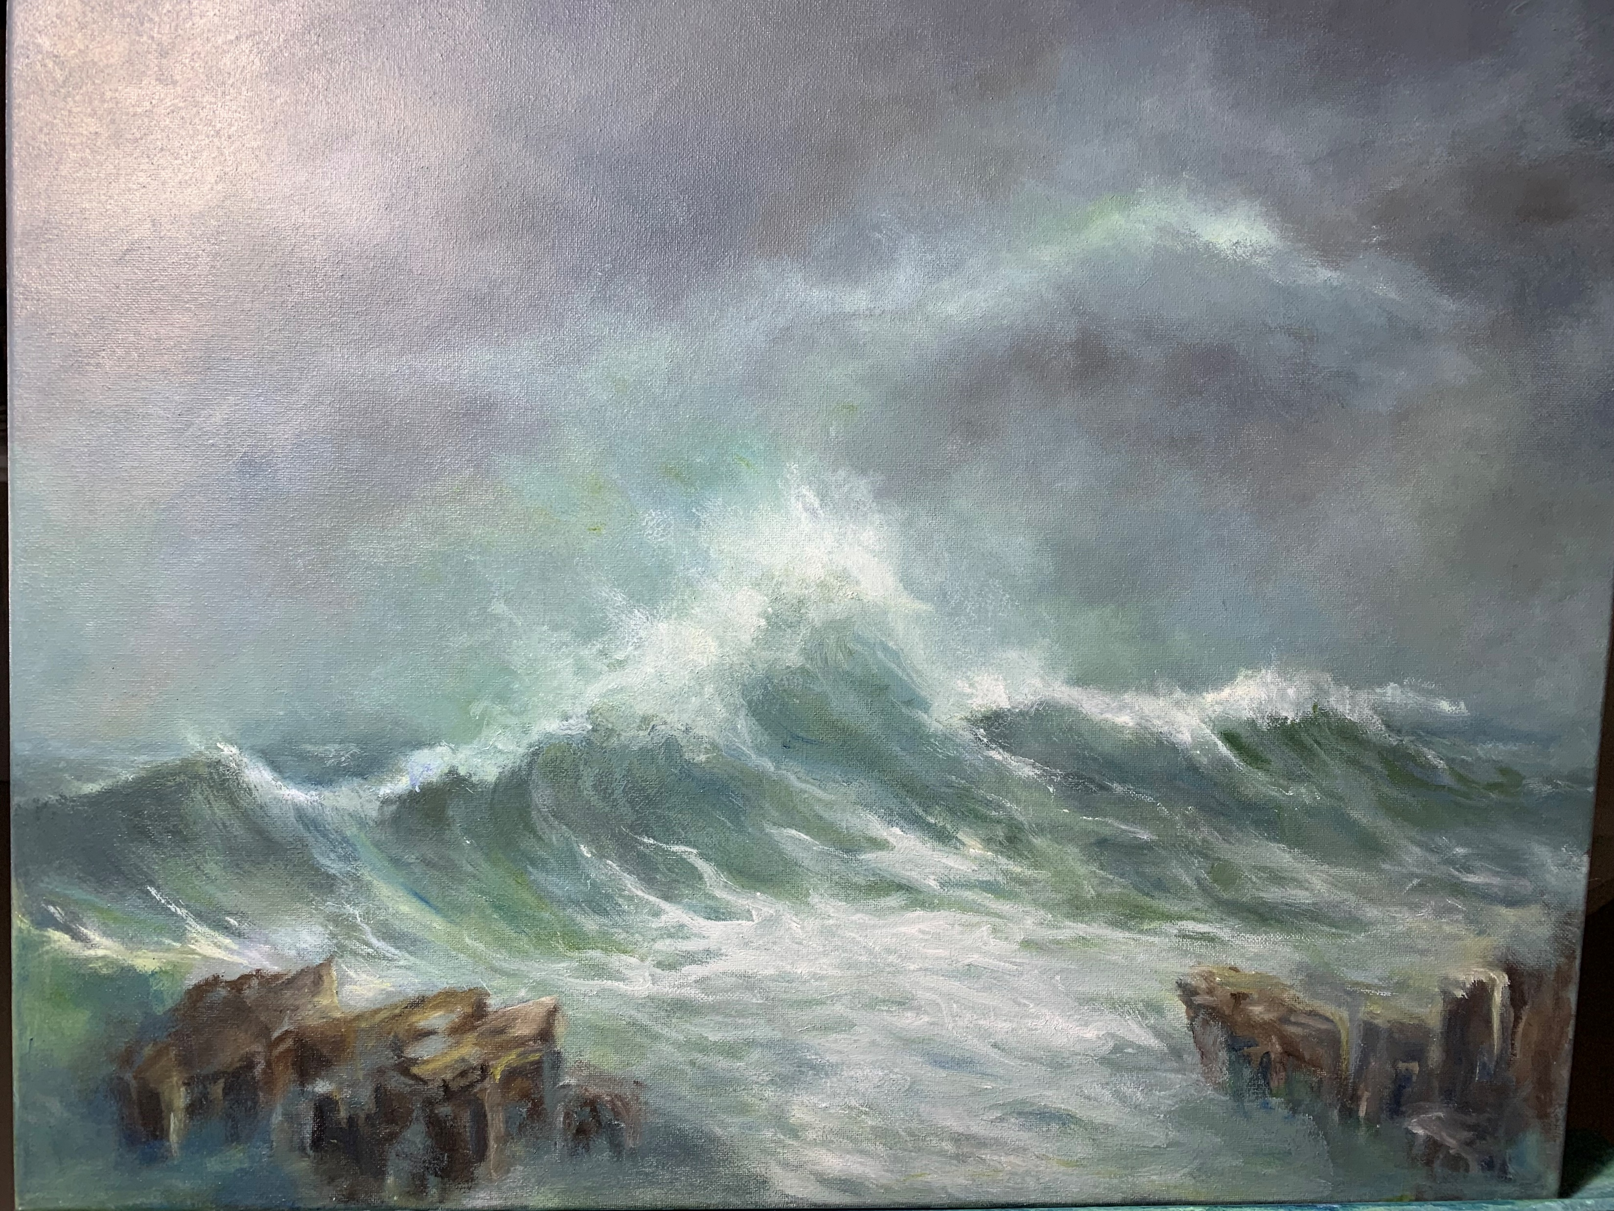

Slide 44
“The goal of art isn’t to attain perfection. The goal is to share who we are. And how we see the world” (Rubin, 2023, p. 177).

Slide 45
Creativity Neurotransmitters
Creative expression activates four “feel-good” neurotransmitters:
Dopamine: Provides reward perception, elevates mood, increases relaxation, enhances reflection and learning.
Serotonin: Stabilizes emotions.
Oxytocin: Provides sense of connectiveness. (dark side: high during war)
Endorphins: Ease pain, elevate mood.

Slide 46
Poetry
Poetry is the oldest form of written literature, dating back at least 4,300 years, and typically passed down generations through the oral tradition.
Our brains process poetry differently from prose.
Poetry can communicate before it is understood.
Poetry more than any other literary form demonstrates the complexities with which our brain constructs the world in and around us because it unifies thought and language, music and imagery in a clear, manageable way.
Poetry stimulates reward areas of the brain, and those associated with meaning-making and the interpretation of reality (DMN).
Poetry offers a safe way to engage with difficult emotions.
Poetry is particularly effective in inducing intense involvement.
Writing (or reading) poetry can help the brain to stop replaying worrying thought patterns, activating neuroplasticity processes in the brain.
Makes us more self-reflective.
Poetry taps into analogy and conceptual combination to create metaphors.

Slide 47
Brain Science and Creativity

Slide 48
Current Scientific Research on the Brain and Creativity
Focus now is more on networks than centers.
Our brains are complex and interconnected systems.
Executive function (EF) is a network.
Default mode network (DMN) is a group of brain regions that form a network.

Slide 49
Executive Function
Executive Function (EF) is the management system of the brain.
EF is the capacity to manage one’s thoughts, actions, and emotions in order to achieve one’s goals.
  Paying attention
  Organizing, planning, prioritizing
  Starting tasks and staying focused on them to completion
  Understanding different points of view
  Regulating emotions
  Self-monitoring (keeping track of what you’re doing)
Beta waves – (13-14 hertz) occur during conscious activity, used for concentration and focus and executive function.

Slide 50
Default Mode Network
The DMN shows lower levels of activity when we are engaged in a specific mental task such as paying attention or thinking with a specific goal in mind, such as being focused on solving a problem.
The DMN shows higher levels of activity when we are awake and not involved in any specific mental exercise.
  Our mind is wandering and we’re daydreaming,
  We’re self-reflecting; having self-referential introspective thoughts,
  We’re recalling memories,
  We’re envisioning the future,
  We’re integrating past information with the current situation.
  We’re creating and editing stories and narratives.
We often assemble and test our ideas and thoughts while in the DMN, with no plan or direction whatsoever.
DMN is more active in the morning.

Slide 51
EF, DMN, and Creativity
DMN forms associations, connections.
DMN: Alpha waves – (8-12 hertz) occur in conscious relaxing such as meditation
EF attention to real things; DMN attention to imaginary things.
Creativity increases when EF decreases.
During artistic activity, the EF and DMN cooperate to give direction to thoughts.

Slide 52
“Aha” Moments
Initial discomfort of not knowing followed by sense of relief with “aha” moment.
Comes suddenly.
Is emotional—amygdala lights up.
Feels right.
Usually pleasurable [Dopamine activated in brain (reward system)].
Alpha waves for a split second before switching to gamma waves. [Gamma waves- (up to 140 hertz) highest frequency. Tell us how new connections are made in the brain.]

Slide 53
The Right Hemisphere of the Brain
At first the right hemisphere of the brain was thought to be useless!
Right brain injuries result in serious cognitive problems: how to make sense of the whole—see connections.
Left brain handles denotation; right brain handles connotation.
Western culture favors the left brain!
Reason, logic, executive function, practicality, success (especially financial success), downplay of emotion, etc.
Culture has an impact on how you perceive and respond to something.
Importance of enriched environments to neuroplasticity.
For artists, drawing by use of negative spaces.

Slide 54
Getting Inspired 2.0
Comes from Latin inspirare, to breathe in or blow into.
To create space for inspiration, we might try quieting the mind : meditation, awareness, silence, contemplation, any ritual that helps us fend off distraction and get us into the DMN.
BUT, inspiration is not something to rely on. We can simply wait.
Epiphanies are hidden in the most ordinary of moments.
To vary your inspiration, consider varying your inputs.
  Break habit
  Look for differences
  Notice connections
When flowing, keep going.
Get through a rough draft. A full, imperfect version is generally more helpful than a seemingly perfect fragment.

Slide 55
Moment of Inspiration
I buried my bone today
Not thinking
Just knowing
That tomorrow
I might forget…
Might forget
I had a bone
But if I remembered
Surely, I’d forget where it was.

Slide 56
Creativity-Supporting Habits
Set a window of time during which you allow your imagination to soar.
Find the rituals that best support your work. If you set a routine that is oppressive, you’ll likely find excuses not to show up.
Shake it up. Keep the ritual, but change the elements of the ritual.
If you commit to working for half and hour a day, something good can happen that generates momentum.
Limit your practical choices to free your creative time by reducing your daily life-maintenance tasks. (Einstein wore the same thing daily: a grey suit.)

Slide 57
Characteristics of Creative People
Exploration of boundaries:
  Assumptions
  Flaws
  Implications
  Systems
Openness
Love of ambiguity
A certain immaturity, e.g. playfulness, childlike wonder

Slide 58
Thoughts and Habits Not Conducive to Creative Work
Believing you’re not good enough.
Feeling you don’t have the energy it takes.
Mistaking adopted rules for absolute truths.
Not wanting to do the work (laziness).
Not taking the work to its highest expression (settling).
Having goals so ambitious that you can’t begin.
Thinking you can only do your best work in certain conditions.
Requiring specific tools or equipment to do the work.
Abandoning a project as soon as it gets difficult.

Slide 59
Thoughts and Habits Not Conducive to Creative Work
Feeling the need to have permission to start or move forward.
Letting a perceived need for funding, equipment, or support get in the way.
Having too many ideas and not knowing where to start.
Never finishing projects.
Blaming circumstances or other people for interfering with your process.
Believing a certain mood or state is necessary to do your best work.
Prioritizing other activities and responsibilities over your commitment to making art.
Distractibility and procrastination.
Impatience.
Thinking anything that’s out of your control is in your way.

Slide 60
Rules
Rules by their nature are limitations.
If we’re aiming to create works that are exceptional, most rules don’t apply.
Instead of sounding like others, value your own voice. Develop it. Cherish it.
As soon as a convention is established, the most interesting work would likely be the one that doesn’t follow it.
It is a healthy practice to approach our work with as few accepted rules and limitations as possible.
Often, the most innovative ideas come from those who master the rules to such a degree that they can see past them or from those who never learned them at all.

Slide 61
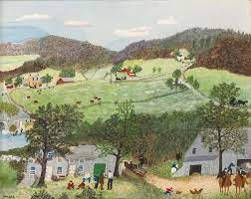

Slide 62
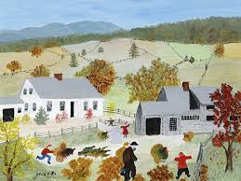

Slide 63
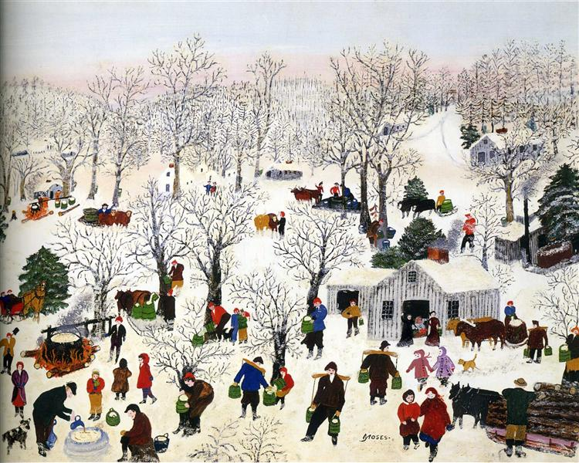

Slide 64
Getting Beyond Blocks
Take small steps. Write one line per day. Paint without a plan.
Change the environment.
Change the stakes. “I have to show a painting this month.”
Invite an audience. Being observed changes how an artist acts.
Change the context. For example, change to whom a poem is written or a song sung.
Alter the perspective.
Write for someone else.
Add imagery. Interchange art forms.
Limit the information.

Slide 65
Gathering and Planting Seeds (Rubin)
Gather seeds (potential ideas, projects) without forming conclusions about their value or fate. Doing so can get in the way of their potential.
Water them with attention and see if they take root. Whereas having a specific vision of what a seed will become could serve as a helpful guide in later phases. In this initial stage, it may cut off more interesting possibilities.
The most exciting seed may not ultimately yield fruit.
Be wary of crossing items off your list too quickly.
Sometimes the purpose of the seed is to propel us in a completely different direction.

Slide 66
Experimentation Phase
Begin to play with different combinations and possibilities.
  One of the fun parts of the project because nothing is at stake.
  Involves playing with forms and seeing what takes shape.
  There are no rules.
Conclusions are stumbled upon.
How do we know when an idea is flourishing?
  Most accurate signposts are emotional, not intellectual.
  Excitement tend to be the best barometer for selecting which seeds to focus on.

Slide 67
Craft Phase
Completing the work!
One of the least glamorous parts of the creator’s job.
Can be a struggle to carry on.
Consider crafting more than one experiment at a time. Working on several often brings about a healthy sense of detachment.
When solely focused on one, it’s easy to get tunnel vision. While it may appear a project’s moving in the right direction, we are too closely entwined with it to know.
Stepping away and returning with fresh eyes brings clearer insight into next steps.
Switching to other projects will engage different muscles and patterns of thinking, which may shed light on paths otherwise unseen.
Avoid showing it too soon, and if you do, remember it’s your work, not that of someone else.

Slide 68
Wanting to outperform another artist or make a work better than theirs rarely results in true greatness. “Comparison is the thief of joy”- Theodore Roosevelt

Slide 69
“Great art is an invitation, calling to creators everywhere to strive for still higher and deeper depths” (Rubin, p. 239).

Slide 70
“The goal of art isn’t perfection. The goal is to share who we are. And how we see the world” (Rubin, p. 177).

Slide 71
“When making art, we create a mirror in which someone may see their own hidden reflection” (Rubin, p. 178).

Slide 72
Sometimes our work shows a point of view that, at the time, we don’t understand.

Slide 73
“Can great art come from conformity? And what is the purpose of being an artist if we deny our unique personal point of view?” (Rubin, p. 180)

Slide 74
Where do you create? Where do you feel most creative?

Slide 75
We tend to believe that the more we know, the more clearly we can see the possibilities available. That is not the case with creativity.The impossible only becomes accessible when experience has not taught us limits.

Slide 76
Antenna
We are all antenna (conduits) for ideas from “somewhere else”, “the beyond”, “something we may not logically grasp and understand.
Something still mysterious about where creative thoughts, ideas, acts come from.
Signals coming through to us are energetic more than tactile, intuitively perceived rather than consciously recorded.
Creativity is enhanced when one has sensitive antennas.

Slide 77
“Imagination is more important than knowledge. For knowledge is limited, whereas imagination embraces the entire world, stimulating progress, giving birth to evolution.” – Albert Einstein

Slide 78
Intuition: The “Uncommon Sense”
Creativity as a “whole-body” experience. Neurotransmitters in the gut and the heart. Gut feelings tied to creativity.
Vast network of communication throughout body.
The entire body is a map of the subconscious mind. Beyond our structured imagining we are continuously communicating with the world inside and around us (Bain quote p, 152).
Mind balks at what might lie beyond logic and reason: What value is a creative act if it has no apparent application, such as making money with it?
Exercise: Imagine opposites and experience them simultaneously: horse’s muzzle and fingers scraping a blackboard. Practice = laying down virgin neuronal patterns.

Slide 79
Quest for efficiency discourages looking too deeply.
Creativity requires patience.
We tend to believe that the more we know, the more clearly we can see the possibilities available.
That is not the case with creativity.
The impossible only becomes accessible when experience has not taught us limits.
If we approach a task with ignorance, it can remove the barricade of knowledge blocking progress.
Experience provides wisdom to draw from, but it tempers the power of naivete.

Slide 80
Exercise: Obstruction
Sit down and without lifting your pen or stopping, and for five minutes, write down all the ways that you “do” obstruction. Keep writing until 5 minutes are up even if you repeat the same thing.
Name or describe the stressful thought, feelings, and sensations that come up in relationship to the creative session. Without censoring yourself, write all of them down. Choose the thought, feeling, or sensation that feels most stressful and let it speak to you. When you feel that stress come up, ask, “Where am I coming from?” Then repeat that question for every answer you get until you sense you have come to a bottom line.

Slide 81
Capturing Idea Birds
Record or write down ideas.
Unless you “cage” it, it will fly away.
John Patterson, president of National Cash Register, demanded that employees keep a “little red book” to capture thoughts and ideas. Those who did not were fired. He died while writing in his “little red book.”

Slide 82
The more ingrained your adopted approach, the harder it is to see past it.
Though experience doesn’t rule out innovation, it can make it more difficult to access.
As artists, we aim to live in a way in which we see the extraordinary hidden in the seemingly mundane. Then challenge ourselves to share what we see in a way that allows others a glimpse of this remarkable beauty.

Slide 83
Theatre answers a profound human longing to be acknowledged, a longing to be seen.
Overcoming the distraction of prior knowledge.

Slide 84
“There is infinite energy and vibration in the universe, there are also unending ways the arts aid in cultivating well-being. They help us navagate the uncertainty and unpredictability of life and ride the wave of complex emotions and feelings” (Magsamen & Ross, 2023, pp. 57-58).

Slide 85
Brain studies show that rote expression, e.g. tracing, is not a natural state.

Slide 86
Source
Something outside of us.
Source as energy (vibrations).
Source as a cloud: Always changing form.
Tactile/senses detect relatively stronger more direct energy signals.
“These precious wisps arise from the unconscious like vapor…” (p. 14) Professor Richard Foster talks about the invisible links between things.

Slide 87
Synesthete
Cross-connection of senses occurs in the brain, called a synesthesia (Greek word that loosely means “joined perception.”
Sees relationships. Interdisciplinary, for example
Synesthete will “see” music as colors and patterns, see time as a landscape—gives perception of time a tangible structure.
Kandinsky artist of music.
Looking for an recognizing patterns: not too simple, not too complicated

Slide 88
Boredom and Creativity
What are the advantages of being bored?
Boredom is not knowing what to do because there’s nothing you want to do “To suffer without suffering, to want without desire, to think without reason” Fernando Pessoa
Having routines can open up opportunities for creativity—goal isn’t to always be organizing your life.

Slide 89
The Brain and Creativity
https://www.youtube.com/watch?v=K12I72d X5no

Slide 90
Clues
Material for our work surrounds us.
Look for clues pointing to new methods or ways to further develop current ideas.
Clues often are subtle transmissions: they are easy to miss.
We can’t control clues or will them to be revealed.
Sometimes it helps to have a strong intention to find a specific answer.
Other times, letting go of that intention altogether can help you find your way.

Slide 91
Association cortex- last to fully develop

Slide 92
“Aha” Moment
Delta waves (less than 4 hertz) occur during deep sleep
Theta waves (4-8 hertz) during light sleep.
Alpha waves – (8-12 hertz) occur in conscious relaxing such as meditation
Beta waves – (13-14 hertz) occur during conscious activity, used for concentration and focus and executive function.
Gamma waves- (up to 140 hertz) highest frequency. Tell us how new connections are made in the brain.
Alpha waves for a split second before switching to gamma waves.

Slide 93
Brainbanks
Collect and store ideas in a container.
Interesting ads, quotations, designs, ideas, questions, cartoons, pictures, doodles, words that might trigger ideas by association.
When looking for new ideas, shake up the container and pull out one or two items at random to see if they can trigger a thought that might lead to a new idea.

Slide 94
Changing the Context
The context in which something is placed changes the way it appears.
Changing the context helps stimulate new ideas.

Slide 95
Morning Pages are three pages of longhand, stream of consciousness writing,
done first thing in the morning. *There is no wrong way to do Morning Pages*–
they are not high art. They are not even “writing.” They are about
anything and everything that crosses your mind– and they are for your eyes
only. Morning Pages provoke, clarify, comfort, cajole, prioritize and
synchronize the day at hand. Do not over-think Morning Pages: just put
three pages of anything on the page...and then do three more pages tomorrow.

Slide 96
Spiritual Dimensions of Creativity
A way of looking at the world as a place where deeper meanings lay beneath the surface.
“The things we believe carry a charge whether they can be proven or not” (Rubin, p. 32).
“Faith allows you to trust the direction without needing to understand it” (Rubin, p. 32).
Sense of connection.

Slide 97
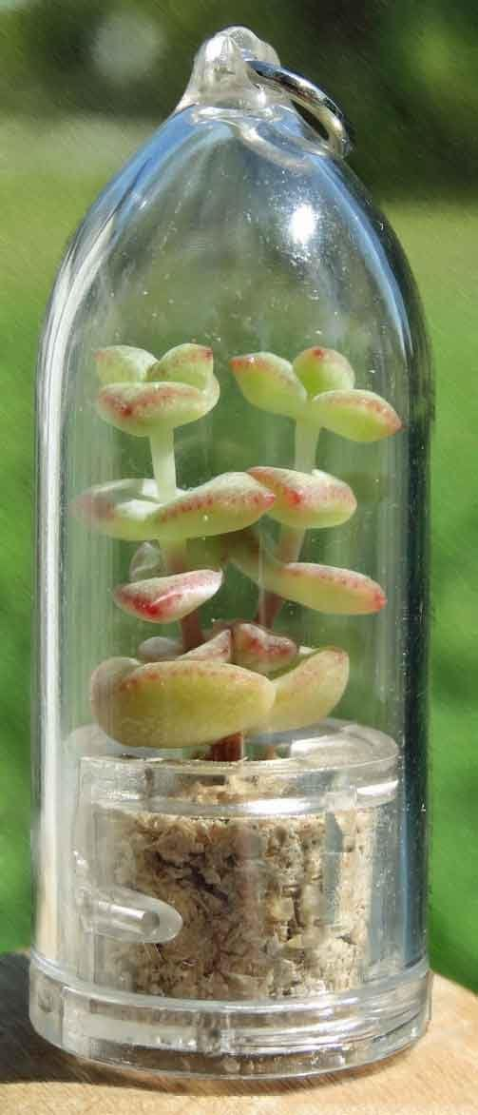
Crossbreeding
Example: Key chain plant
Slips of paper with random names of plants, objects, animals, business-related objects.
Ask group what the hybrid looks like and have the provide a detailed description.

Slide 98
Work from Children’s Drawings
J. M. W. Turner.
Had children make drawings from watercolors and paper.
Sometimes he’d suggest a general theme, sometimes not.
Would use drawings to stimulate his own imagination.

Slide 99
There is the life we are given, and then there’s the life we create (Bain)
Carl Jung: Creativity is the expression of a duality of functions: it’s both personal and an expression of our collective unconscious—collective human experiences; archetypes.
Maslow: Creativity at top of hierarchy within self-actualization.
Picasso said creativity is an act of destruction: shatters our conditioning, unexamined, beliefs, assumptions, which exposes how much we take for granted. (Conditioning)
We draw inside the lines,

Slide 100
Some Final Thoughts
“Creativity is born in a receptive state of being.” (Bain)
Feminine energy is generative; masculine energy is sustaining.
Emotions are the wellspring of creativity; learning how to have a relationship with emotions is more powerful than overcoming them.
Allow emotions to move through you.
Do not fight an obstruction. Insecurity and perfectionism. Recognize them, admit them, and summon the courage to change. Own it, understand it, understand yourself.
Seeking validation for creative works makes creativity no longer about self-expression; it’s about validation.

Slide 101

Perceptual Illusions
Ponzi illusion
Ebbinghaus Circles illusion
Café Wall Illusion https://michaelbach.de/ot/ang-cafewall/

Slide 102
Centering a Challenge
Write it as a definite question, beginning “In what ways might I…” (Called the invitational stem that helps from settling on a problem statement that may reflect only one perception of the problem.)
Vary the wording of the challenge by substituting synonyms for key words.
Stretch the challenge to see the broader perspective.
  Divide it into subproblems.
  Solve the subproblems.
  Keep asking “how else?” and “why else?”

Slide 103
Paradox (Bain)
The holding of two or more separate frequencies of idea and/or action simultaneously without any loss of attention assets from either task.
A channel of communication through which our ultracreative selves reach out to us from beyond logic and reason.
Exhilaration + serenity/experienced simultaneously = beauty

Slide 104
Scamper
SCAMPER is a checklist of idea-spurring questions.
  Substitute something
  Combine it with something else
  Adapt something to it
  Modify or magnify it
  Put it to some other use
  Eliminate something
  Reverse or rearrange it

Slide 105
Wearing
The ache of possession
Wore a groove
Into the plastic of our lives
Deliberate repetition
Of an unfinished song
A skipping phonograph--that familiar beat
Throbbing into the night
Resounding off the concrete
In our veins
The needle etched a nerve
Like chalk unyielding on a blackboard
Rigor mortis of the living
They call it
Immobilization by familiar rhythms
And, of course, the fear
Of being the one
To change the record

Slide 106
“Aha” Moments

