Slide 1
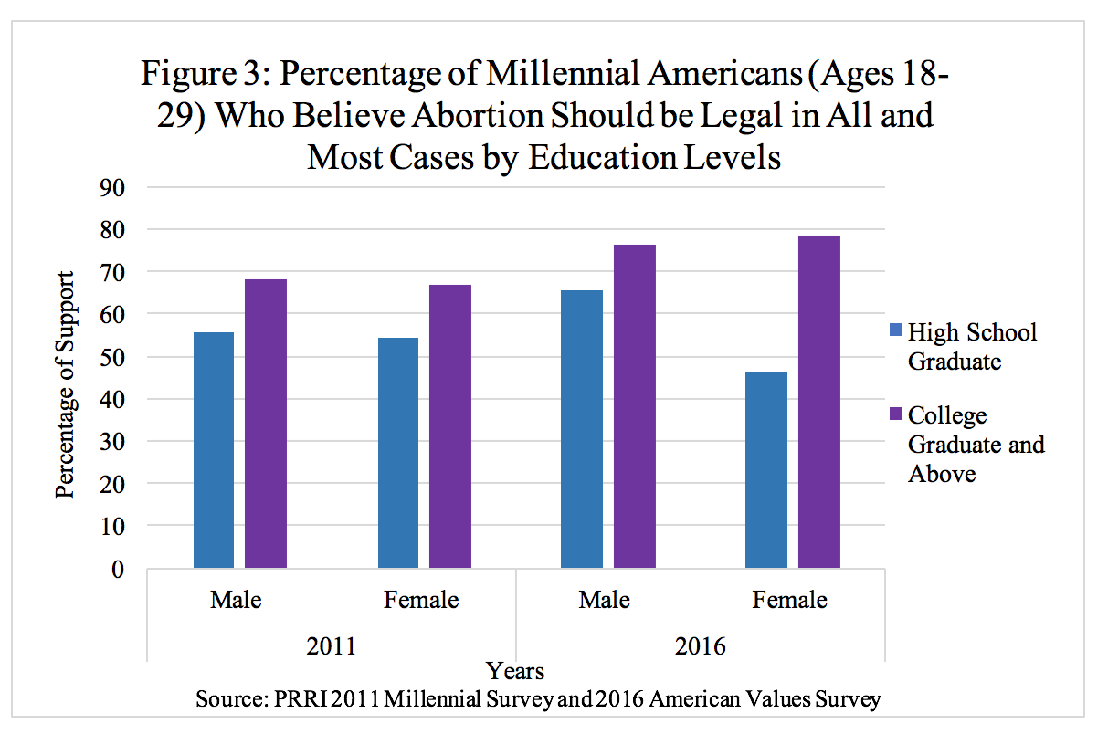
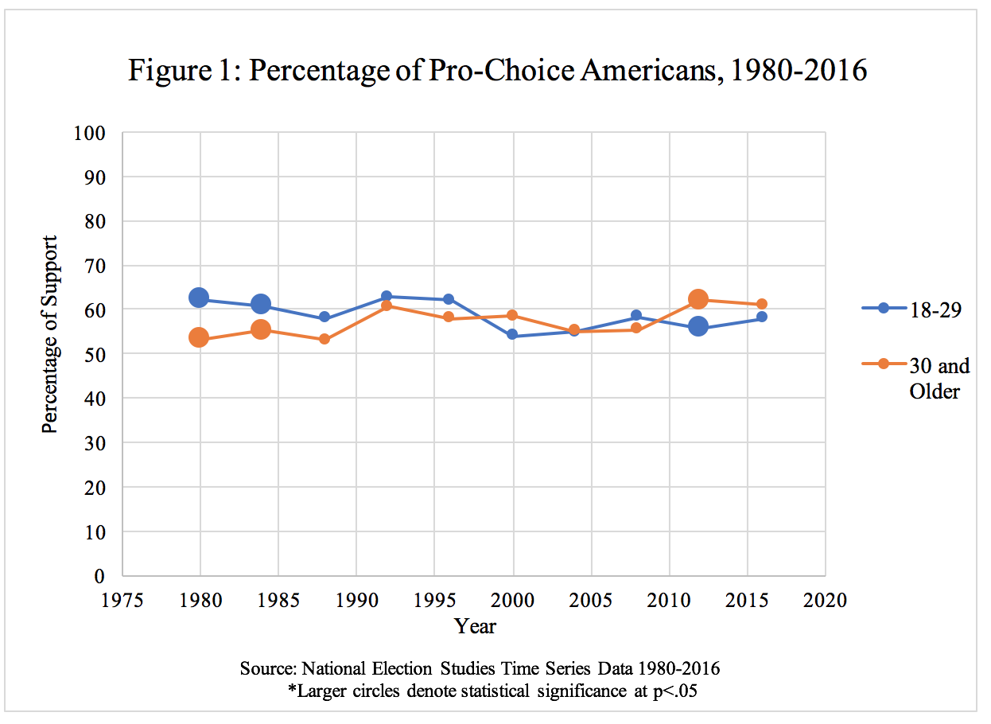
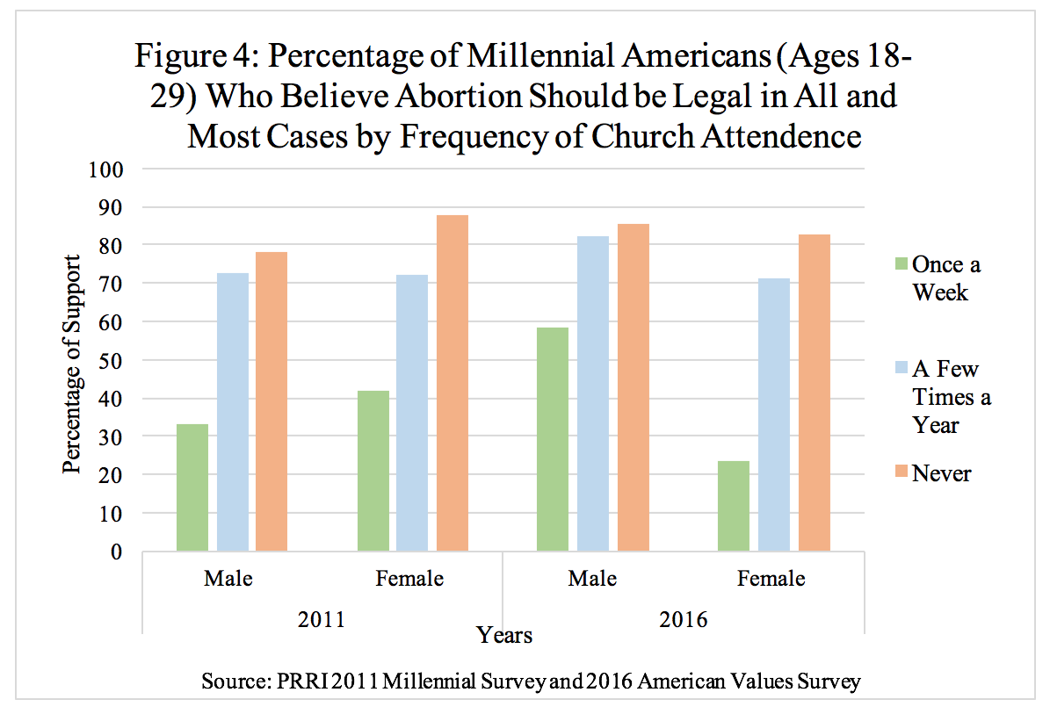
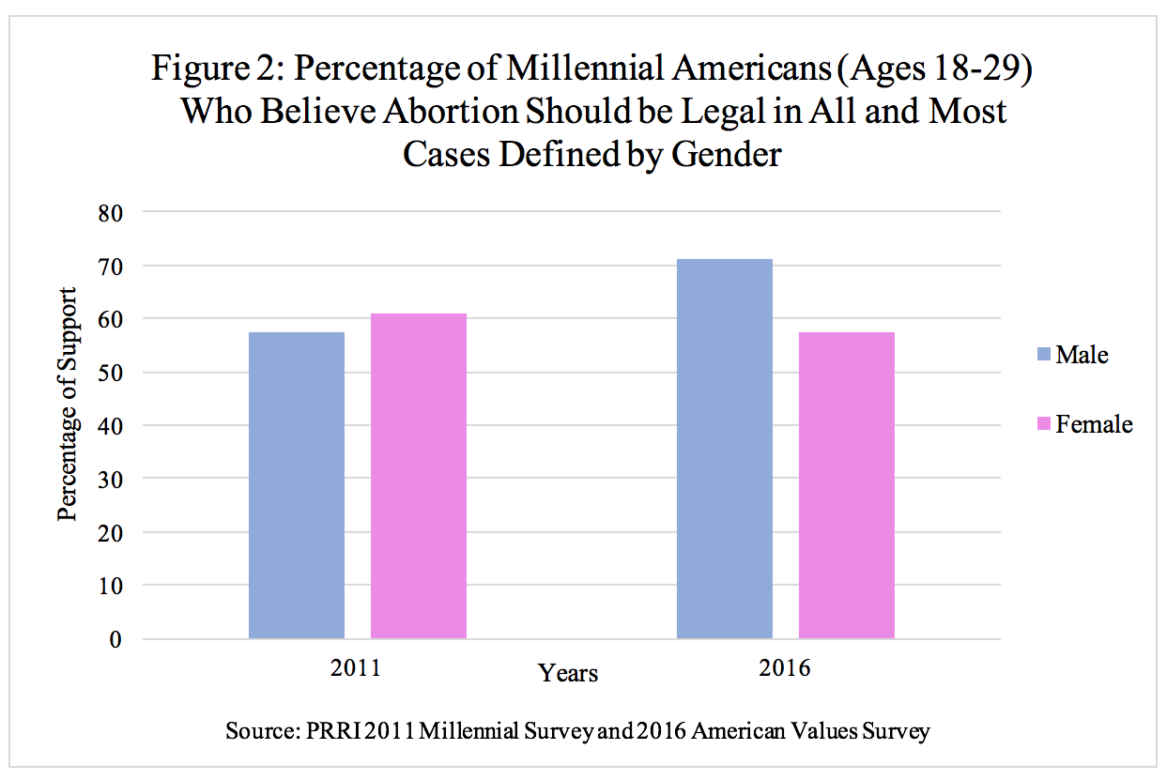
The Mysterious Millennial: Changes in Abortion Attitudes
Political Science Senior Capstone Poster Presentation by Julia Zheng; Advised by Dr. Melissa Deckman
Abstract
Methods
Results
Scholars have long since determined the factors that impact the abortion attitudes of the general public, but do these factors similarly impact millennial Americans? I examined ANES data from 1980-2016 to determine whether trends in support of abortion rights between the American public and younger Americans are different and found that despite younger Americans being less religious and better educated, their support for abortion rights has not significantly strayed from what is found among the general public. Then, looking at 2011 and 2016 PRRI data, I examined how gender, education, and religiosity impact abortion attitudes among millennials. With respect to gender, I found that in 2016, millennial men were significantly more likely than millennial women to be pro-choice. This is unexpected given the scholarly consensus on the lack of effect that gender plays in abortion attitudes, but when I examined education as a factor, the opposite is true, and college-educated millennial women in both 2011 and 2016 were significantly more likely than both high-school-educated women and men of all education levels to hold pro-choice sentiments. Lastly, looking at religiosity, I found that there is no question whether religious affiliation impacts abortion attitudes, as frequency of church attendance has a direct effect on support for abortion rights regardless of gender, with increased attendance aligning with lower support for abortion.
To determine if, over time, the abortion attitudes of younger Americans and the general public differs, I analyzed the ANES Time Series Data from 1980 to 2016 using SPSS, with every election year serving as as a data point in this range. Then, to see if millennial abortion attitudes differ from the general public, I used PRRI’s 2011 Millennial Survey and 2016 American Values Survey.
Next, turning to look at millennials (18-29 year olds) specifically, I used the PRRI’s 2011 Millennial Survey and the 2016 American Values Survey to determine if and how the factors of gender, education, and religiosity impact abortion attitudes.
Figure 3 shows that a college education raises the likelihood of support for abortion rights among millennials. In particular, college-educated women in 2016 are more likely to be pro-choice than both men, regardless of education level, and women with only a high school degree. Only the differences between men and women in 2016 are statistically significant, signaling that perhaps a higher level of education corresponds to a heightened political awareness regarding the increasingly restrictive abortion laws.
Results
Background
Some scholars, such as Jelen and Wilcox, find that through the theory of generational displacement, as every subsequent generation becomes better educated and more secular, their attitudes towards abortion should become more liberalized and replace the ideals of older generations on this issue. However, there have been numerous mixed findings, such as those by Strickler, Danigelis, Grandberg and Grandberg on where millennials stand in regard to abortion attitudes.
Additionally, as alluded to by the generational displacement theory, Jelen and Wilcox among others have found education to be one of the most telling factors of abortion attitudes among the general public. Jerit et al. also noted that higher educated individuals are more politically knowledgeable as a result of their schooling and of their increased attention to politics.
There has been a general consensus among scholars, including Hertel and Russel and Grandberg and Grandberg, that gender is an insignificant indicator of abortion attitudes among the general public when other factors such as education and religiosity are controlled for.
Furthermore, according to Jelen, Wilcox, and Jones et al., religiosity has been and remains a significant indicator of abortion attitudes.
Figure 1 shows that over time, from 1980-2016 there have only been three statistically significant years in which the abortion attitudes of younger Americans differed from the general public. Although there are fluctuations in support for abortion rights among younger Americans, their overall abortion attitudes are similar to the general public.
Finally, Figure 4 illustrates how religiosity is a statistically significant indicator of abortion attitudes among millennial Americans in both 2011 and 2016. Regardless of gender, men and women who never attend church are the most likely to support abortion rights compared to men and women who more frequently attend church.
Objectives
Conclusions
From my study, I concluded that millennial abortion attitudes are similar to the general public despite the theory of generational displacement, which states that the abortion attitudes of better educated and more secular millennial Americans should be more liberalized.
Regarding gender, despite scholarly literature, I found statistically significant differences between the levels of support for abortion rights of millennial men compared to millennial women in 2016. Given the scholarly consensus, it is surprising to find that gender as a factor does in fact influence abortion attitudes. However, it is important to note that this can only be observed when gender is the sole consideration for abortion attitudes.
Finally, with respect to religiosity, it is not a surprise to find that this factor is just as important in influencing millennial abortion attitudes as in the general public’s abortion attitudes. Religiosity continues to be a powerful indicator in measuring support for abortion rights.
In the face of the increasingly conservative political climate where stricter abortion laws are being proposed and passed both on the state and federal levels, the data shows that it is perhaps educated millennial women who are the most likely demographic to become more progressive in their views on abortion laws. This coincides with scholarly findings, which observe that higher educated individuals are more politically knowledgeable and attentive as a result of their schooling.
Do millennial abortion attitudes differ from the general public?
Do gender, education, and religiosity play a role in shaping the abortion attitudes of millennials?
Does a more conservative political climate motivate younger women to become more progressive in their attitudes about abortion?
Figure 2 shows that, despite scholarly literature deeming gender as an insignificant indicator of abortion attitudes, there are statistically significant differences in 2016 between the gender attitudes of millennial men compared to millennial women. Contrary to conventional wisdom, the graph shows that men are more pro-choice than women in 2016 when gender is the sole factor considered in abortion attitudes.

