Slide 1
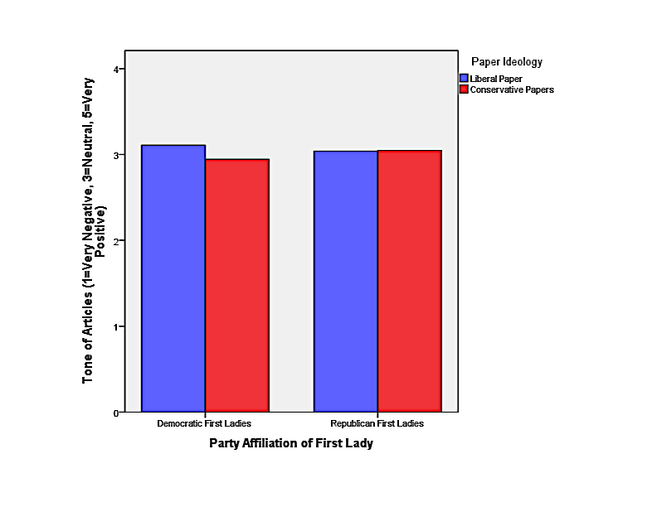
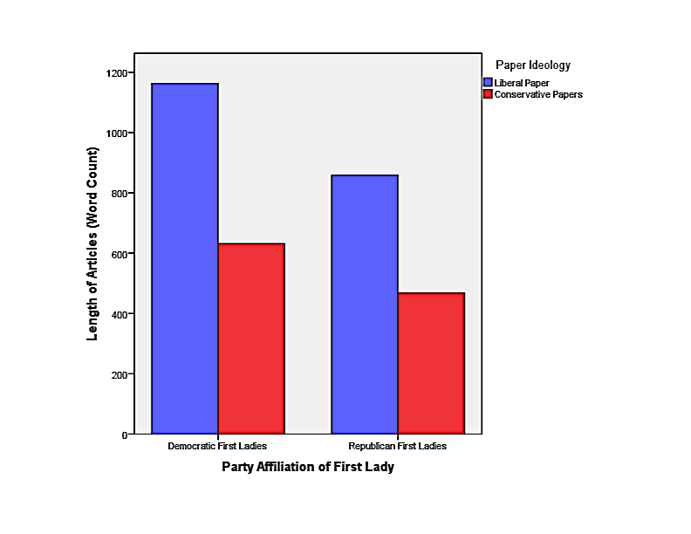
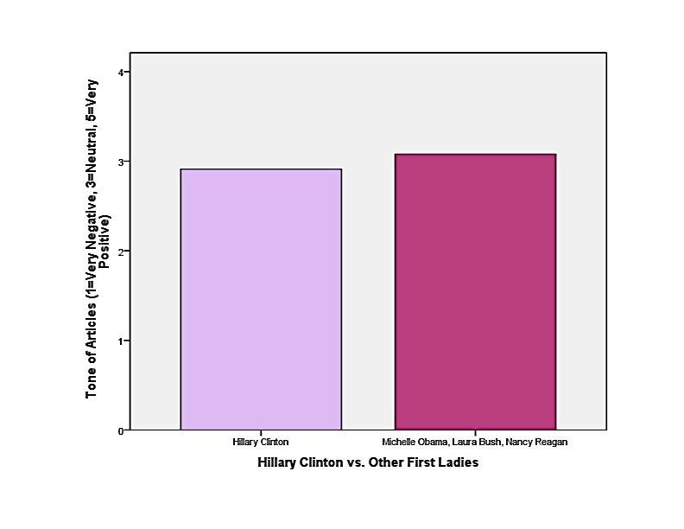
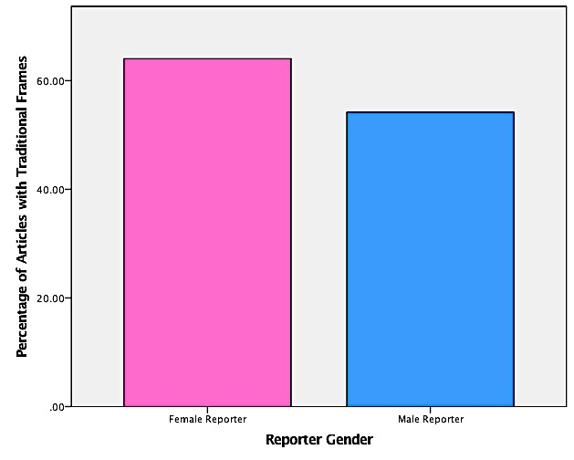
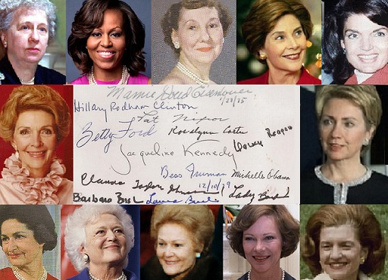
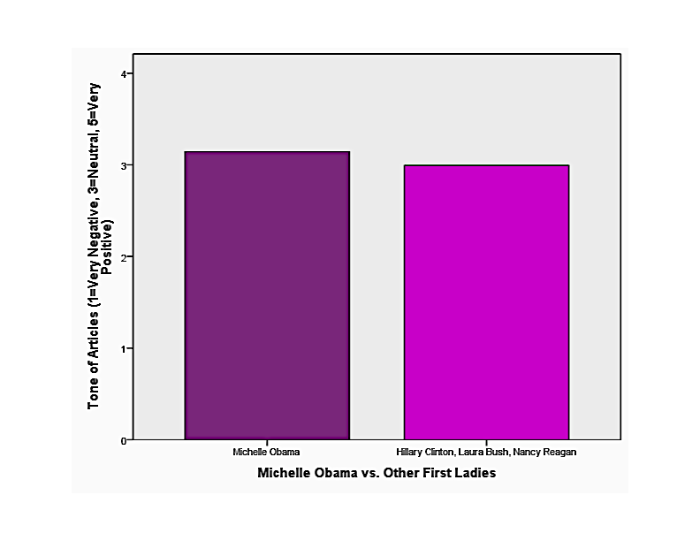
Newspaper Coverage of First Ladies: Objective Truth or Biased Opinion?
By Molly Igoe
Abstract
Research Methods
Findings
First ladies have been subjected to intense public scrutiny since Martha Washington’s tenure. This scrutiny has not faded, but has increased over time into the present-day with the advent of the 24/7 news cycle. The purpose of this thesis is to examine newspaper coverage of four first ladies, Michelle Obama, Laura Bush, Hillary Clinton, and Nancy Reagan. This paper analyzes the tone of coverage for less traditional first ladies, Hillary Clinton, because of her large political role, and Michelle Obama, as the only non-white first lady. This thesis also compares how the liberal paper and conservative papers cover the Democratic first ladies, versus how they cover the Republican first ladies, to see if the first lady’s party affiliation impacts coverage. Lastly, the differences between how female and male reporters cover the first ladies are analyzed.
I utilized content analysis to look at the tone, frames used, reporter gender, and ideological bias of newspaper coverage of first ladies using approximately 200 articles for each first lady: 100 from The Washington Post, the more liberal paper, and 100 articles total from the New York Post, the Pittsburgh Post Gazette, and The Wall Street Journal, the more conservative papers
For each article, I recorded the tone, the frame used, the reporter’s gender, the length, and the date it was written
I used systematic random sampling, looking at every third article dating from the start of her husband’s inauguration to his last day in office
Hypothesis 3 and 4: Coverage of Democratic first ladies will be more substantial, in terms of length, and more positive in the liberal paper. Coverage of Republican first ladies will be less substantial and more positive in the conservative papers
Figure 3: Tone for Democratic
and Republican First Ladies by
Paper Ideology
Figure 4: Length of Articles for Democratic and Republican First Ladies by Paper Ideology
Findings
Background
Hypothesis 1: Hillary Clinton, who has a less traditional background, will receive more negative coverage than the other first ladies
For Figure 4, for Democratic first ladies, the articles in the liberal paper are much longer than the articles in the conservative papers. The same trend is true for Republican first ladies, with the liberal paper covering first ladies with longer articles. Both of these are significant. It’s also important to mention that the articles for Democratic first ladies are longer than for Republican first ladies.
Scholars like Scharrer and Bissell looked at newspaper coverage of Barbara Bush, Nancy Reagan, and Hillary Clinton, and found that when the story was framed with the first lady being involved in politics, the tone of coverage was more negative in comparison to when other frames were used
Burden and Mughan looked just at newspaper coverage of Hillary Clinton from 1993 to 1997 and found that the more negative stories there were of her, the lower her approval rating were; they concluded that negative coverage had a greater impact on the public’s perception of her than positive coverage
In general, first ladies have historically been covered in the media with traditional duties in mind, including being a social trendsetter and a hostess for the White House. As the expectations for first ladies have evolved into a more public role, coverage has reflected the debate over women’s proper place in the public sphere
Figure 1: Tone of Coverage for Hillary Clinton
vs. Other First Ladies
Tone
1: Very Negative
2: Negative
3: Neutral
4: Positive
5: Very Positive
For Figure 3, Democratic ladies, the difference in tone from the liberal paper, at 3.11 and conservative papers, at 2.94 is small, but still significant. For Republican first ladies, the difference is almost unnoticeable, and is not enough to be significant.
For Figure 1, the tone of coverage for Hillary Clinton is more negative, at 2.91, compared with the tone of coverage for the other three first ladies, at 3.08
Although this isn’t a huge difference, it is statistically significant
Hypothesis 5: Articles written by female reporters will focus on traditional aspects of the first lady institution, while articles written by male reporters will focus on untraditional aspects
Figure 5: Frames Used by Female and Male Reporters
Frames
Traditional: Escort, Symbol, Pet
Project, Protocol
Untraditional: Policy, Campaign,
International
For Figure 5, female reporters are more likely to employ a traditional frame, at 64% when covering first ladies, while male reporters are less likely to use a traditional frame, at 54%.
Hypothesis 2: Michelle Obama, who is the first African-American first lady, will receive more negative coverage than the other first ladies
Figure 2: Tone of Coverage for Michelle Obama vs. Other First Ladies
Conclusion
Photo courtesy of
Firstladies.org
For Figure 2, the tone of coverage for Michelle Obama is more positive, at 3.14, while the tone for the other first ladies is lower, at 2.99
This is not a huge difference in tone, but it is statistically significant
The media, at least the newspapers I looked at, are neutral when covering first ladies
The lack of difference in tone of coverage based on paper ideology points to the conclusion that first ladies are not truly viewed as partisan actors
The finding that female reporters utilize traditional frames more frequently indicates that they are still assigned to cover first ladies based on their domestic and traditional duties, which is unfair to both the first ladies and the reporters
In general, the frames used were crucial in how the first lady was presented. They really shaped if she was to be viewed in a positive or a negative light
There is still much work to be done in terms of how the media represents first ladies simply as women performing certain expected duties within the expectation of a traditional role
Research Questions
How do frames impact newspaper coverage of first ladies?
Will first ladies who have a less traditional background receive more negative coverage than first ladies who have more traditional background?
Is newspaper coverage of first ladies impacted by their party affiliation?

