Slide 1
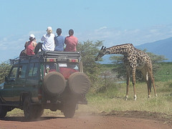

















Exploring International Studies at Washington College
For more information,
visit our website:
is.washcoll.edu
Can you identify the flags of 17 of our 22 partner school countries below?
http://is.washcoll.edu

Slide 2
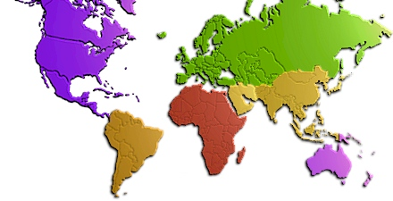
“IS” within a “WAC” education:
Our “intensely personalized education” is rooted in small classes and enhanced by personalized advising.
Our emphasis on writing begins in your first year with 2 small classes devoted to developing writing and research skills, continues through the sophomore and junior year with “writing intensive courses,” and ends with the “senior capstone experience” (SCE).
Instruction and opportunities for every level of student:
High achievers benefit from our Presidential Fellows program, Society of Jr. Fellows, academic honors societies, Phi Beta Kappa
Slower developers benefit from strong advising, peer tutors, Office of Academic Skills programs, varied teaching styles.
All students benefit from our Writing Center, campus-wide programs, faculty relationships.
http://is.washcoll.edu

Slide 3
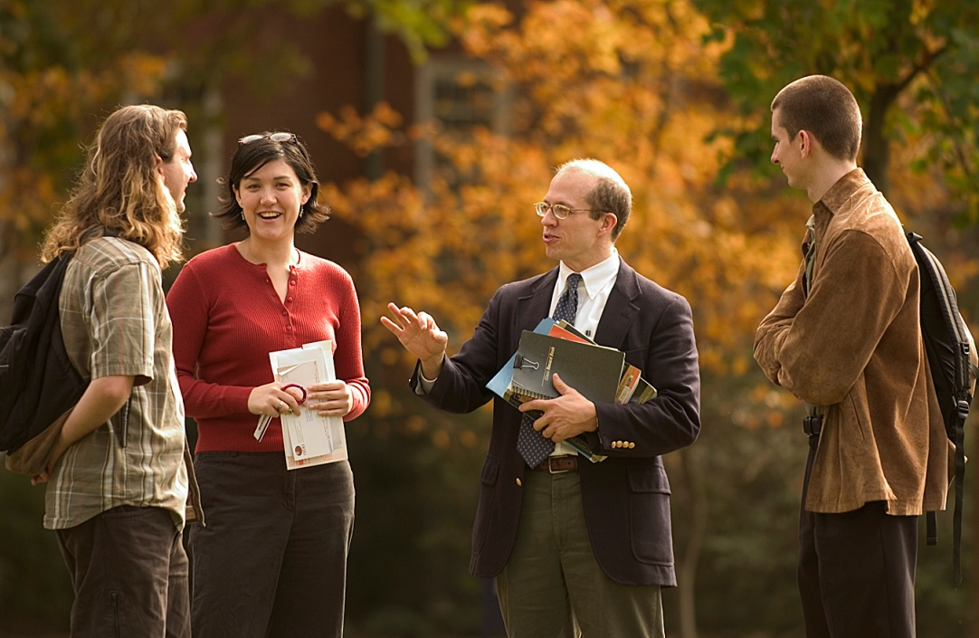
The International Studies Major:
An Interdisciplinary Study of the World
  Required Disciplines:
  * Anthropology * Economics * Foreign Language
  * History * Political Science
Elective Disciplines:
  Art
  Business
  Education
  Philosophy
  And more!
http://is.washcoll.edu

Slide 4
Requirements for the major:
5 introductory-level & 9 upper-level courses in anthropology, economics, history, political science and elective disciplines
Intermediate-level study of a foreign language, including one of the 4 taught at WAC (French ▪ German ▪ Chinese ▪ Spanish), or including other language study abroad (such as Arabic, Japanese, Italian, Portuguese, or Xhosa).
“Experiential education” (internship, model diplomacy, etc.)
Study abroad for at least one semester - two semesters encouraged (choose from 31 different programs in 22 countries)
Senior capstone experience
Thesis or self-designed project
  + a “poster presentation” at the annual symposium
http://is.washcoll.edu

Slide 5


Summer Study Abroad
In addition to semester abroad programs in 22 countries, Washington College offers the following short-term opportunities:
International Studies in Tanzania
  Focus on development issues across the country (two-week study tour in May)
International Studies in Cuba
  Havana, Trinidad and other locales (two weeks in early January)
English Studies in England
  Kiplin Hall and surrounding
  countryside (two weeks in June)
Environmental Studies in Ecuador
  Galapagos Islands/Quito on ship
  and land (two weeks in June)
  + Others in development or one-off trips
http://is.washcoll.edu

Slide 6

Regional Concentrations
(available to all majors)
REGIONS
African Studies
Asian Studies
European Studies
Latin American Studies
Near Eastern Studies
Common requirements:
  One semester abroad (or summer program) in the region
  One year of language study from the region
  Two introductory-level courses in anthropology, economics, history, or political science.
  Two courses on the region at WAC
  Two courses on the region while abroad
  Research paper on the region of concentration
Earn your COMPLETION CERTIFICATE &
NOTATION ON GRADUATION TRANSCRIPT
http://is.washcoll.edu

Slide 7
Functional Concentrations
(available to all majors)
Global Business Studies
Peace and Conflict Studies
Earn your COMPLETION CERTIFICATE &
NOTATION ON GRADUATION TRANSCRIPT
See is.washcoll.edu for concentration requirements
http://is.washcoll.edu

Slide 8
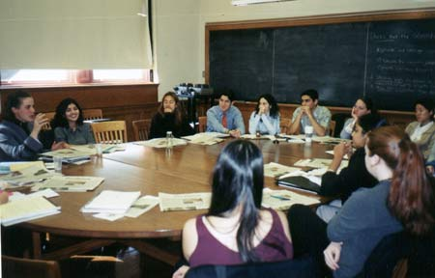
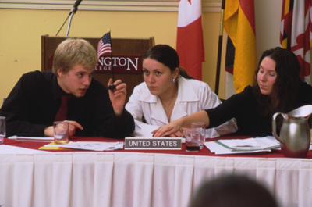
Special Programs & Student Conferences
Model United Nations
  Yale University (Fall)
    about 16 students per year
  World Model UN (Spring)
    about 12 juniors/seniors
Service Academy Assemblies
  Naval Academy Foreign Affairs Conference
    Annapolis, Maryland (Fall)
  West Point Student Conference on United States Affairs
    West Point, New York (Fall)
http://is.washcoll.edu

Slide 9

Internship Programs
Students regularly have secured internships with:
Washington Center for Internships and Academic Seminars
  Congress, embassies, businesses
Hansard Parliamentary Internship
  University of London, England
United Nations Offices
  In New York and across the world
U.S. Department of State Internship
http://is.washcoll.edu

Slide 10
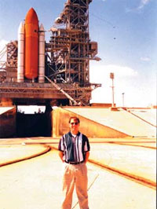


International Studies graduates have found Careers in:
Foreign Service
Import/export business
International banking and finance
Law
Medicine
Non-governmental organizations such as:
  Peace Corps
  Red Cross
  Catholic Relief
The Sciences
http://is.washcoll.edu

Slide 11
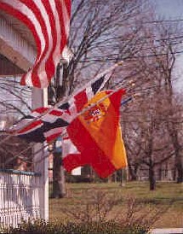
Washington College Students Have Worked in Government Agencies in:
Bangladesh
Barbados
Bolivia
China
Costa Rica
Ecuador
El Salvador
England
Fiji
Gambia
Hong Kong
Indonesia
Ireland
Japan
New Zealand
Pakistan
Philippines
Switzerland
Venezuela
Washington D.C.
http://is.washcoll.edu

Slide 12

Graduate Schools Attended by Washington College International Studies Majors
American University
Dickinson College
Duke University
Fordham University
Georgetown University
George Washington University
London School of Economics and Political Science
New York University
Ohio State University
University of California:
  Santa Barbara
  Los Angeles
University of Chicago
University of Essex
University of Reading
University of Wisconsin – Madison
Yale University
http://is.washcoll.edu

Slide 13

Thank you for your interest in
International Studies!
Dr. Andrew Oros, Director of International Studies
Professor of Political Science & International Studies
Specialist on East Asia and the advanced industrial democracies and American foreign policy
Contact: 410/810-7436 aoros2@washcoll.edu
Dr. Aaron Lampman Dr. Michael Harvey
Associate Professor of Anthropology Associate Professor of Business
Dr. Janet Sorrentino Dr. Nicole Grewling
Associate Professor of History Associate Professor of Modern Languages
Dr. Lisa Daniels Dr. Tahir Shad & Dr. Christine Wade
Professor of Economics (Associate) Professors of Political Science and International Studies
plus associated faculty across the College teaching regular and “special topics” classes, and at our abroad partners…
http://is.washcoll.edu

