Slide 1
SGA Spring ‘21 budget
+ fall ‘20 review

Slide 2
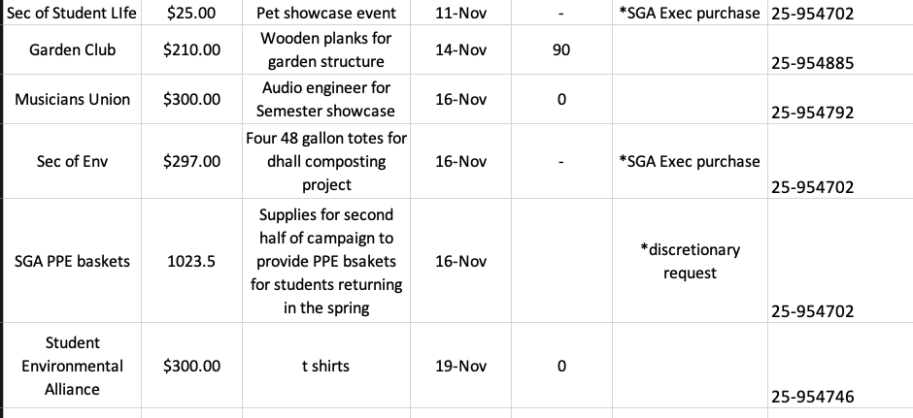
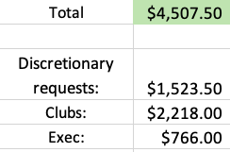
FA20 club/exec/discretionary spending

Slide 3
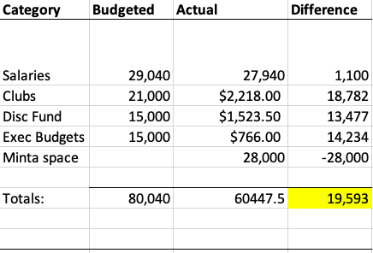
FA20 budget/actual spending
Underbudget across all funding categories
$28,000 contribution to the Office of Intercultural Affairs and related club space in Minta Martin was approved in a Senate Resolution
Even with the unbudgeted Minta contribution, the SGA came in underbudget for the fall

Slide 4
Observations from FA20
Not many discretionary requests
The collaborative requirement came out of concern that clubs would want to do many high cost but low attendance events, but this was not realized
It became evident that there was not really a meaningful distinction between budget requests and discretionary requests in the context of the rolling process
Overall, very underbudget on club spending
Largely because of the inherent challenges of virtual programming
But also perhaps confusion about SGA budgeting during COVID
Leftover funds from the fall semester will be rolled into the spring club budget cap
Slack process worked well for both clubs and us

Slide 5
spring budget:
$1,000 limit for each club
Exec budgets max out at $10,000 across the whole board of 12 members
We are unsure of our possible student activities fee allocation; we may adjust plans to expand funding if we receive an allocation

Slide 6
Notes/changes from fall
$1,000 club spending limit
NO discretionary fund-> DR rolled into regular club caps
Goal-> streamline forms/process for clubs
Requests over $500 will be reviewed by the committee and approved in Senate
Anything under $500 will just be in the Slack
Move budget request form to CampusGroups
All plans must preserve $50k in reserves
This is so that we can operate in future semesters — we rely on reserves to supplement the SGA budget even in normal years

